Slide 1
Digital Input/Output-Based Security Access Indicator
group 01
BSc-CE3

Slide 2
Problem Statement
Many basic embedded systems need to read digital input signals and generate clear output responses. For example, a simple access-control panel may need to detect push-button inputs and display whether access is allowed, denied, or waiting for user action. This project introduces students to digital input/output interfacing using the ATmega32 microcontroller.

Slide 3
Objectives
To design and implement a simple digital access indicator system using ATmega32 GPIO pins, push buttons, LEDs, and a buzzer.

Slide 4
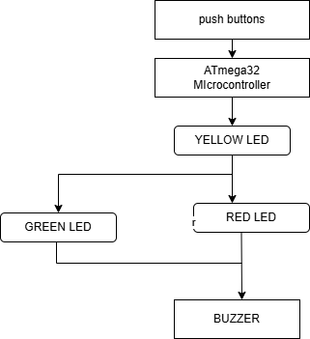
System Block Diagram

Slide 5
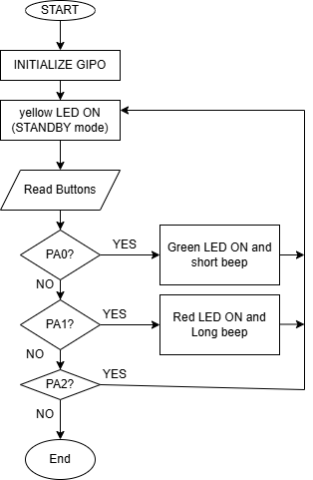
Firmware Flowchart:

Slide 6
Pin Mapping
ATmega32 Pin | Function | Connected Device
PA0 | Digital input | Correct access button
PA1 | Digital input | Wrong access button
PA2 | Digital input | User reset button
PB0 | Digital output | Green LED
PB1 | Digital output | Red LED
PB2 | Digital output | Yellow LED
PB3 | Digital output | Buzzer

Slide 7
System Operation
Standby Mode: Yellow LED ON
Correct button press: Green LED ON and short buzzer beep
Wrong button press: Red LED ON and long buzzer beep
Reset button press: Return standby mode

Slide 8
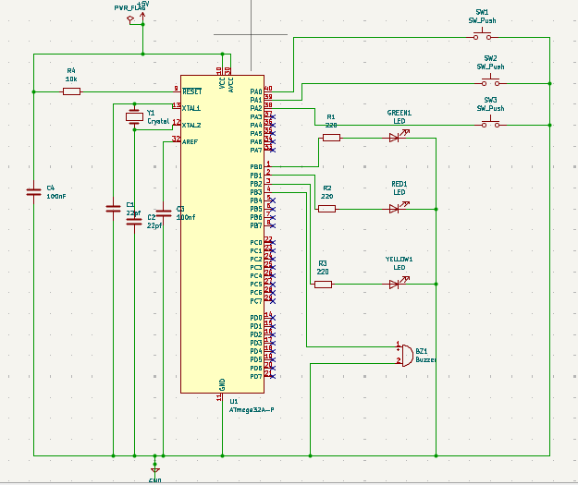
Kicad schematic

Slide 9
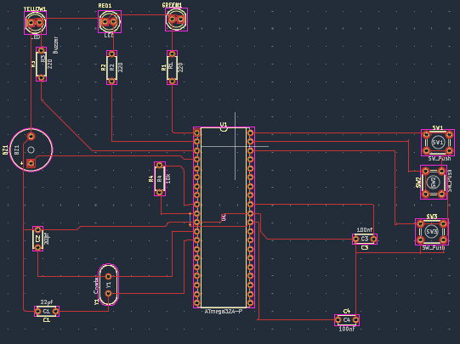
Kicad PCB layout

Slide 10
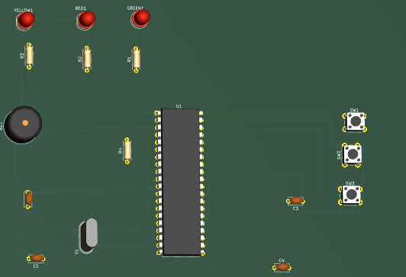
PCB 3D view:

Slide 11
Firmware Development Process
The application firmware was developed in C language for the ATmega32 microcontroller.
The program implements the access control logic, including:
Reading the push-button inputs.
Validating user actions.
Controlling the Red, Green, and Yellow LEDs.
Activating the buzzer during invalid access attempts.
The source code was written and compiled using MPLAB for VS Code.
HEX File Generation
After successful compilation, the compiler generated a HEX (.hex) file.
The HEX file contains the machine code that can be executed directly by the ATmega32 microcontroller.
This generated HEX file was loaded into the ATmega32 in SimulIDE to simulate the complete access control system.

Slide 12
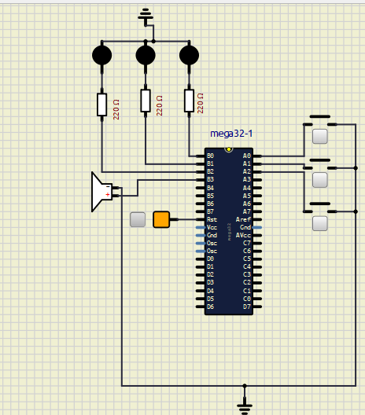
Simulation: SimulIde working simulation

Slide 13
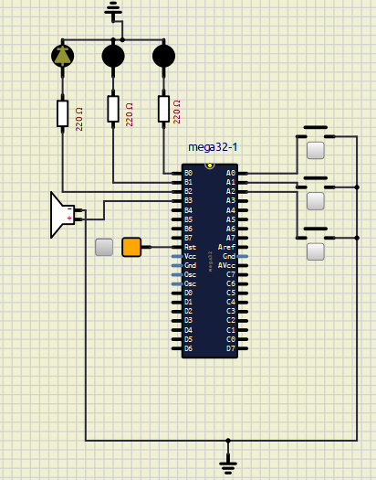
Running simulation (standby mode): only yellow LED is ON

Slide 14

Correct button press: Green LED turn ON and short buzzer beep.

Slide 15
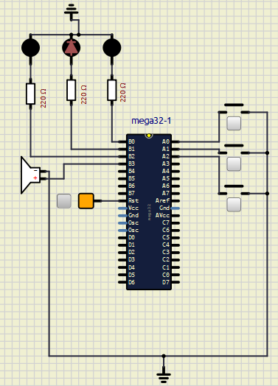
Wrong button press: Red LED turn ON and long buzzer beep.

Slide 16
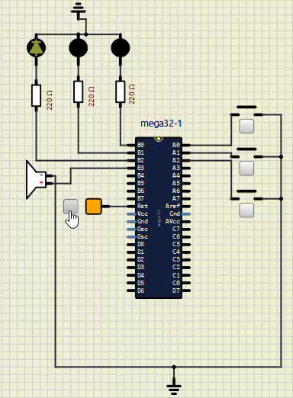
Complete Simulation with reset button operation:

Slide 17
Test result table:
Test case | Input condition | Expected output | Actual output | Status
Test 1 | No button pressed | Yellow LED ON (STANDBY), green LED and RED LED OFF, BUZZER OFF | Yellow LED remained ON, green and red LEDs remained OFF, BUZZER remained OFF | pass
Test 2 | Correct access button | GREEN LED ON, YELLOW and RED LEDS OFF, SHORT BUZZER BEEP | Green LED turned ON and buzzer produced short beep | Pass
Test 3 | Wrong access button | RED LED ON, YELLOW and GREEN LEDS OFF, LONG BUZZER BEEP | Red LED turned ON and buzzer produced a long beep | Pass
Test 4 | Reset button pressed | System return to standby mode with yellow LED ON | System successfully returned to standby mode | Pass

Slide 18
Conclusion:
The ATmega32-Based Access Control and Intruder Detection System was successfully designed and simulated. The project demonstrated the integration of hardware and embedded software to provide reliable access control and intrusion detection. The results confirmed that the system operates as intended, making it a practical, cost-effective, and scalable solution for basic security applications.

